Slide 1
Course : Calculus I
Effective Period : 2023
Basic Derivative Session 4-6

Slide 2

These slides have been adapted from: Stewart, J. D. Clegg, S. Watson (2020). Calculus Early Transcendentals, 9, USA, Cengage Learning, Inc, 2020. ISBN: 978-1337613927
Acknowledgement

Slide 3

Learning Objectives
LO 2:
Explain the properties of derivative to describe geometric and physical problems, and other applications.

Slide 4
Content
1
The Derivative as a Function
2
Derivatives of Polynomials and Exponential Functions
3
The Product and Quotient Rules
4
Derivatives of Trigonometric Functions
5
The Chain Rule

Slide 5
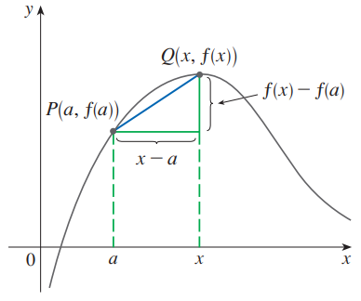
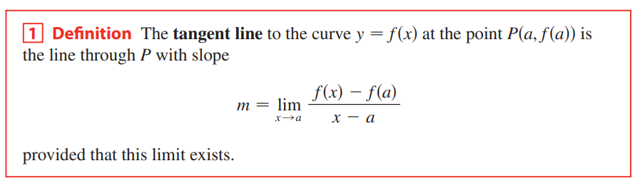
Tangents

Slide 6
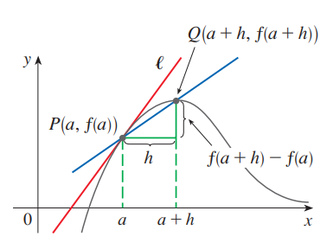

Tangents

Slide 7
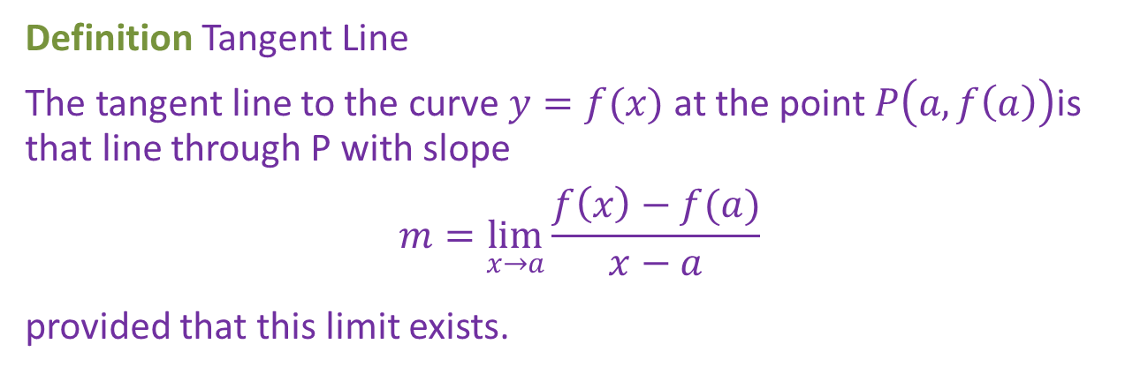

Tangents
Definition Tangent Line
The tangent line to the curve $y=f(x)$ at the point $P\left(a,f\left(a\right)\right)$is that line through P with slope
$$m=\lim_{x→a}{\frac{f\left(x\right)−f(a)}{x−a}}$$
provided that this limit exists.
Notice that as x approaches a, h approaches 0 (because h = x - a) and so the slope of the tangent line in Definition becomes
$$\lim_{h→0}{\frac{f\left(c+h\right)−f(c)}{h}}$$

Slide 8
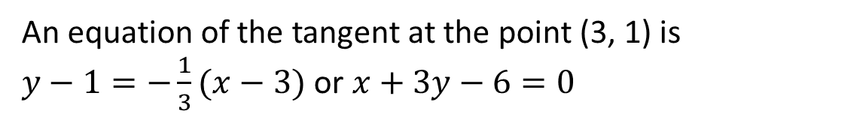
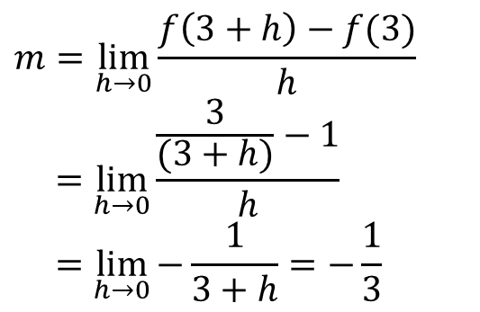
Example 1
Find an equation of the tangent line to the hyperbola $y=\frac{3}{x}$ at the point (3, 1).
$$m=\lim_{h→0}{\frac{f\left(3+h\right)−f(3)}{h}}$$
$$=\lim_{h→0}{\frac{\frac{3}{(3+h)}−1}{h}}$$
$$=\lim_{h→0}{−\frac{1}{3+h}=−\frac{1}{3}}$$
An equation of the tangent at the point (3, 1) is
$y−1=−\frac{1}{3}(x−3)$ or $x+3y−6=0$

Slide 9
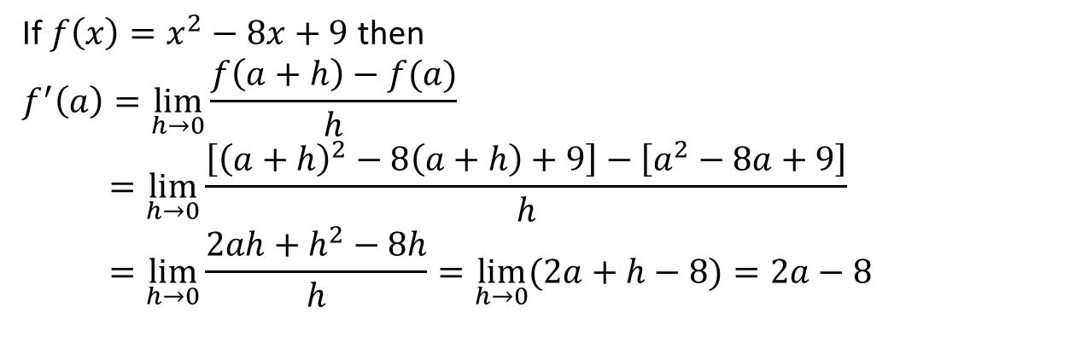
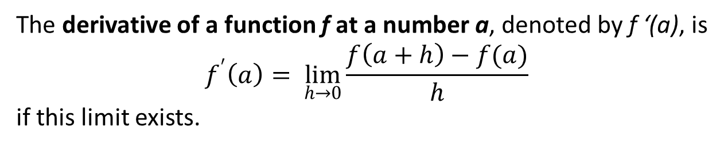
Derivatives
Definition
The derivative of a function f at a number a, denoted by f ‘(a), is
$$f^{′}\left(a\right)= \lim_{h→0}{\frac{f\left(a+h\right)−f(a)}{h}}$$
if this limit exists.
Example
If $f\left(x\right)=x^{2}−8x+9$ then
$$f^{′}\left(a\right)=\lim_{h→0}{\frac{f\left(a+h\right)−f(a)}{h}}$$
$$=\lim_{h→0}{\frac{\left[{\left(a+h\right)}^{2}−8\left(a+h\right)+9\right]−\left[a^{2}−8a+9\right]}{h}}=\lim_{h→0}{\frac{2ah+h^{2}−8h}{h}}=\lim_{h→0}{(2a+h−8)}=2a−8$$

Slide 10
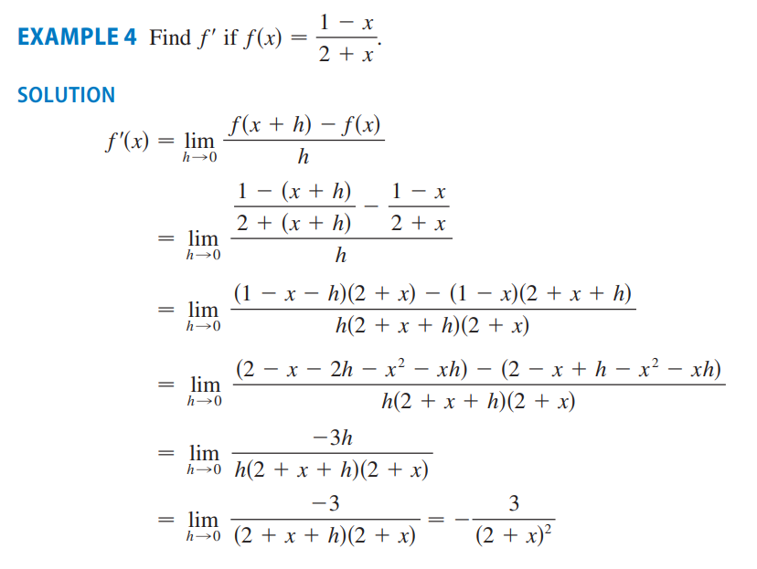

Slide 11

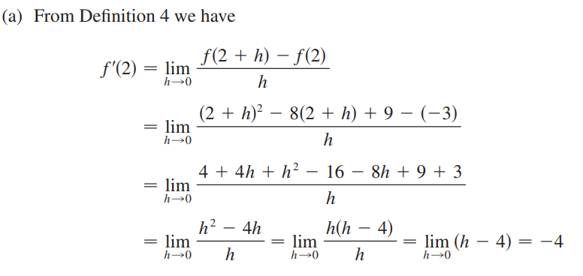
Derivatives

Slide 12
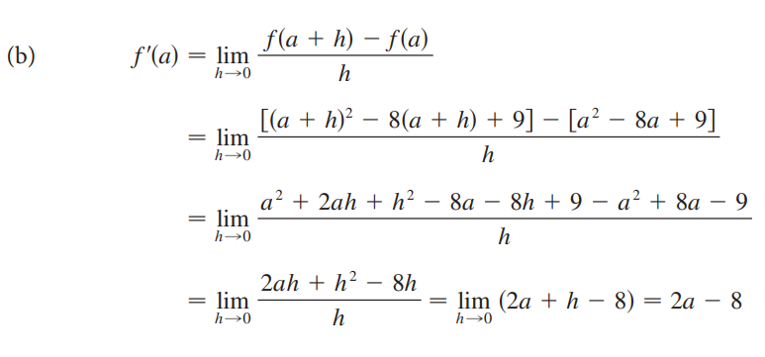
Derivatives

Slide 13



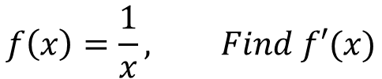
Latihan
a.
$$f\left(x\right)=13x −6, Find f′(4)$$
b.
$$f\left(x\right)=x^{3}+7x, Find f′(x)$$
$$f\left(x\right)=\frac{1}{x}, Find f′(x)$$
c.
d.
$$f\left(x\right)=x^{3}−x, Find f′(x)$$

Slide 14
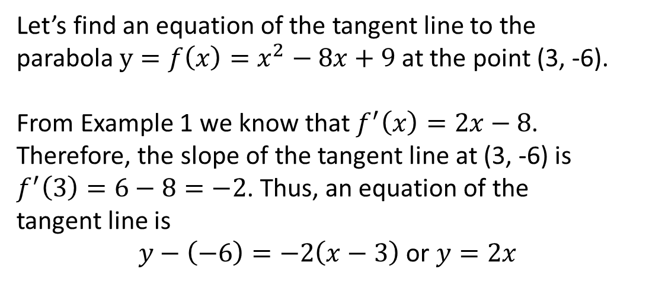
Slope and Derivative
Relationship
The tangent line to y = f(x) at (a, f(a)) is the line through (a, f(a)) whose slope is equal to f ‘(a), the derivative of f at a.
Example
Let’s find an equation of the tangent line to the
parabola $y=f\left(x\right)=x^{2}−8x+9$ at the point (3, -6).
From Example 1 we know that $f^{′}\left(x\right)=2x−8$.
Therefore, the slope of the tangent line at (3, -6) is
$f^{′}\left(3\right)=6−8=−2$. Thus, an equation of the
tangent line is
$y−\left(−6\right)=−2\left(x−3\right)$ or $y=2x$

Slide 15
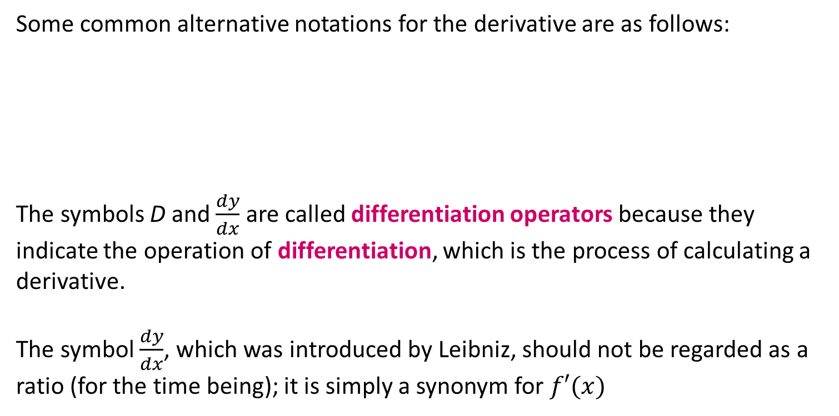
Other Notations
Some common alternative notations for the derivative are as follows:
The symbols D and $\frac{dy}{dx}$ are called differentiation operators because they indicate the operation of differentiation, which is the process of calculating a derivative.
The symbol $\frac{dy}{dx}$, which was introduced by Leibniz, should not be regarded as a ratio (for the time being); it is simply a synonym for $f′(x)$

Slide 16
Higher Derivatives
If f is a differentiable function, then its derivative f’ is also a function, so f ‘ may have a derivative of its own, denoted by f’’, called the second derivative of f because it is the derivative of the derivative of f.
Using Leibniz notation, we write the second derivative of y = f(x) as

Slide 17

Example 2
If $f\left(x\right)=x^{3}−x$ then $f^{′}\left(x\right)=3x^{2}−1$

Slide 18
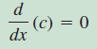
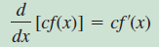
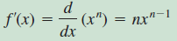
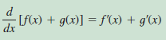
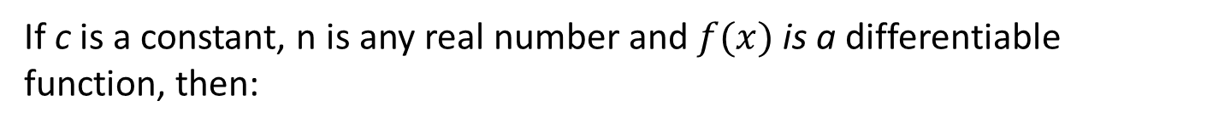
Some Basic Rules
If c is a constant, n is any real number and $f(x)$ is a differentiable function, then:
1
2
3
4

Slide 19

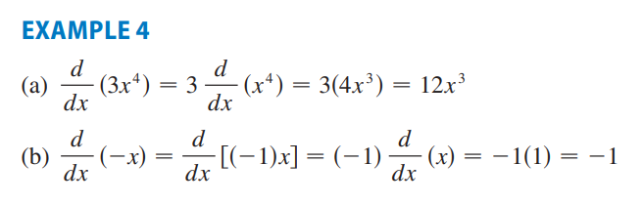


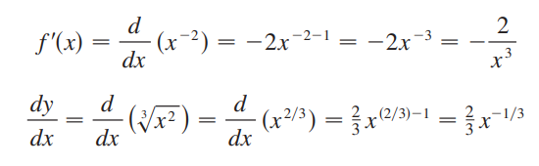


Slide 20
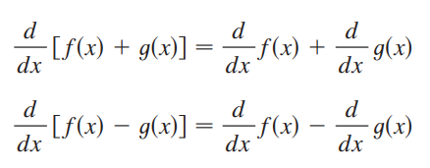
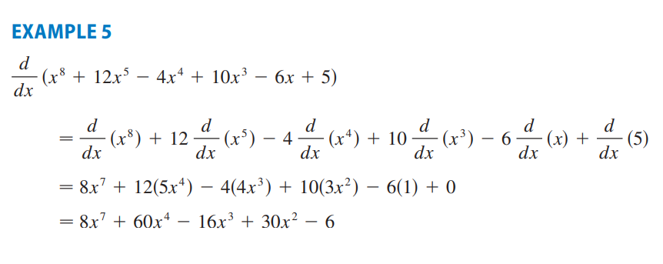

Slide 21
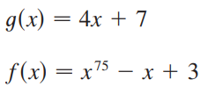

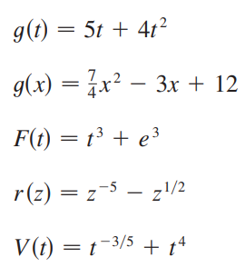
Latihan
1.
2.
3.
4.
5.
6.
7.
8.

Slide 23

Exponential Functions
Definition
e is the number such that $\lim_{h→0}{\frac{e^{h}−1}{h}}=1$
Derivative
Derivative of the Natural Exponential Function $\frac{d}{dx}\left(e^{x}\right)=e^{x}$

Slide 24

The Product Rule
The Product Rule
Example
Suppose that g(x) =(x²+1)f(x) and it is known that f(2) = 3 and f’(2) = -1. Evaluate g’(2).
$$g′(x)=\frac{d}{dx}\left[\left(x^{2}+1\right)f\left(x\right)\right]$$
$$=\left(x^{2}+1\right)\frac{d\left(f\left(x\right)\right)}{dx} + f(x)\frac{d}{dx}(x^{2}+1) \\ =(x^{2}+1)f′(x)+2xf(x)$$
Then $g^{′}\left(2\right)=7$

Slide 25
The Quotient Rule
The Quotient Rule
Example
Let $y=\frac{e^{x}}{1+x^{2}}$ then:

Slide 26
Derivatives of Trigonometric Functions

Slide 27
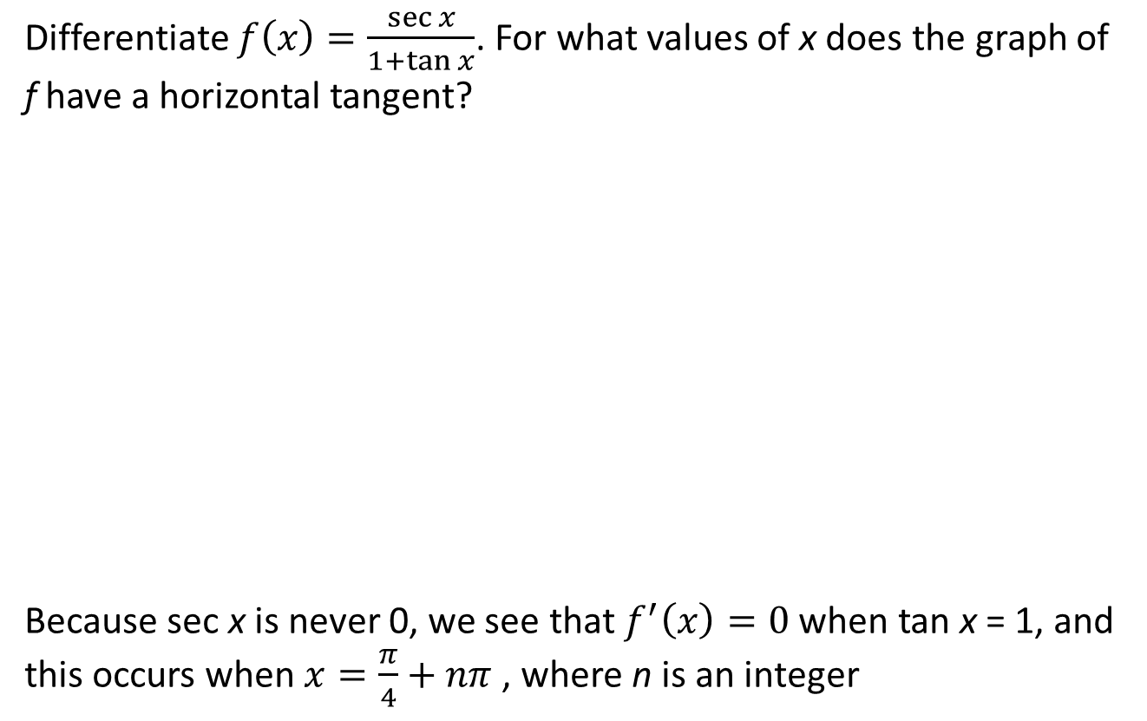
Example 3
Differentiate $f\left(x\right)=\frac{\sec{x}}{1+\tan{x}}$. For what values of x does the graph of f have a horizontal tangent?
Because sec x is never 0, we see that $f^{′}\left(x\right)=0$ when tan x = 1, and this occurs when $x=\frac{π}{4}+nπ$ , where n is an integer

Slide 28
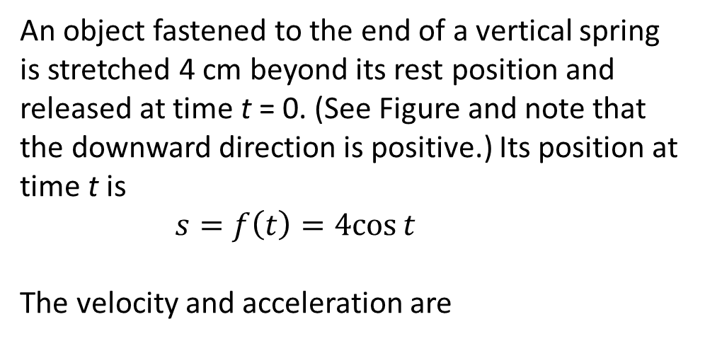
Example 4
An object fastened to the end of a vertical spring is stretched 4 cm beyond its rest position and released at time t = 0. (See Figure and note that the downward direction is positive.) Its position at time t is
$s=f\left(t\right)=4cos{t}$
The velocity and acceleration are

Slide 29
Two Special Trigonometric Limits
Formula
Example

Slide 30
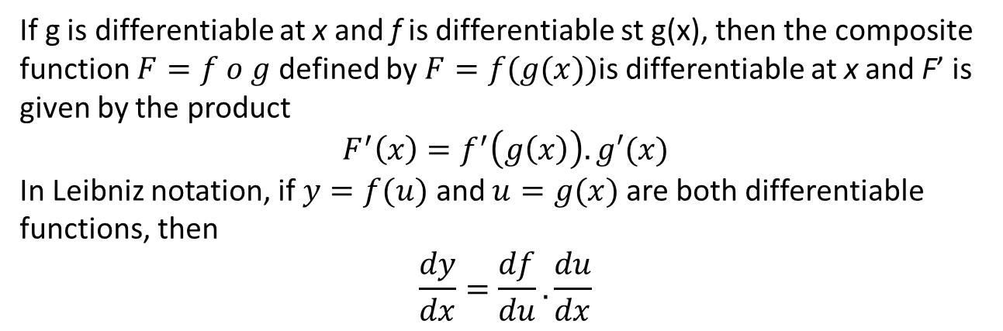
The Chain Rule
The Chain Rule
If g is differentiable at x and f is differentiable st g(x), then the composite function $F=f o g$ defined by $F=f(g(x))$is differentiable at x and F’ is given by the product
$$F^{′}\left(x\right)=f^{′}\left(g\left(x\right)\right).g′(x)$$
In Leibniz notation, if $y=f(u)$ and $u=g(x)$ are both differentiable functions, then
$$\frac{dy}{dx}=\frac{df}{du}.\frac{du}{dx}$$
Note
Formula says that we differentiate the outer function f [at the inner function g(x)] and then we multiply by the derivative of the inner function.

Slide 31
Example 5
1
Let $y=\sin{(x^{2})}$, then
2
Let $y={\left(\sin{x}\right)}^{2}$, then

Slide 32
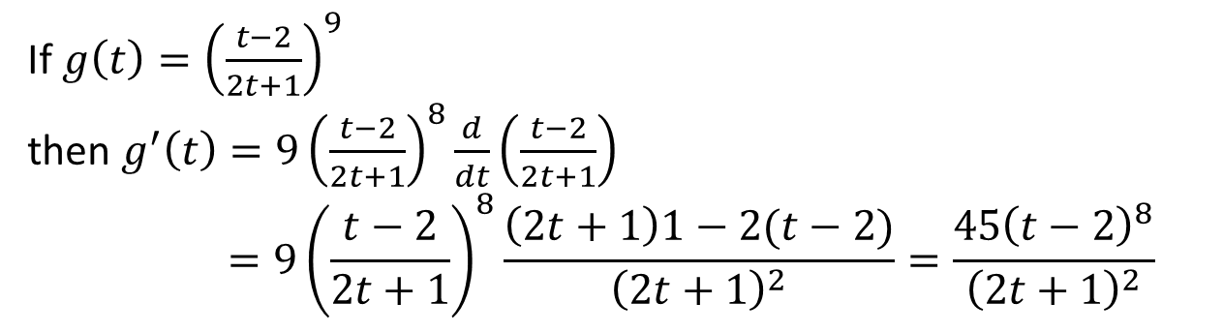
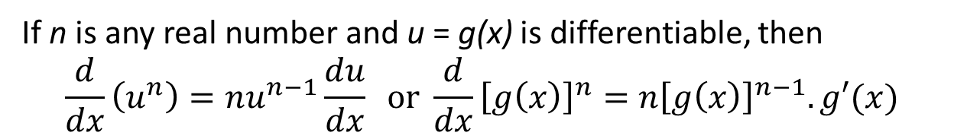
The Power Rule Combined with the Chain Rule
The Product Rule
If n is any real number and u = g(x) is differentiable, then
$$\frac{d}{dx}\left(u^{n}\right)=nu^{n−1}\frac{du}{dx} or \frac{d}{dx}{\left[g\left(x\right)\right]}^{n}=n{\left[g\left(x\right)\right]}^{n−1}.g′(x)$$
Example
If $g\left(t\right)={\left(\frac{t−2}{2t+1}\right)}^{9}$
then $g^{′}\left(t\right)=9{\left(\frac{t−2}{2t+1}\right)}^{8}\frac{d}{dt}\left(\frac{t−2}{2t+1}\right)$
$$=9{\left(\frac{t−2}{2t+1}\right)}^{8}\frac{\left(2t+1\right)1−2(t−2)}{{\left(2t+1\right)}^{2}}=\frac{45{\left(t−2\right)}^{8}}{{\left(2t+1\right)}^{2}}$$

Slide 33
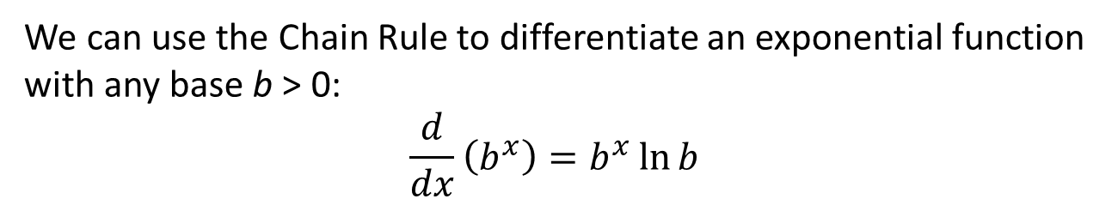
Derivatives of General Exponential Functions
Formula
We can use the Chain Rule to differentiate an exponential function with any base b > 0:
$$\frac{d}{dx}\left(b^{x}\right)=b^{x}\ln{b}$$
Example

Slide 34
Thank You

